Slide 1
Comparison of Clinical Text Embeddings: Approaches and Insights
By- Lovely Kumari
24-02-2024

Slide 2
Introduction
Importance of clinical Text Embedding :
Clinical text embeddings play a crucial role in healthcare by transforming unstructured clinical text data into numerical representations, enabling advanced analysis and interpretation through machine learning and deep learning techniques. These embeddings capture complex semantic relationships and domain-specific knowledge, facilitating tasks such as clinical decision support, information retrieval, and medical knowledge discovery.
Purpose :
This is assignment round for Senior data scientist position at HOLMUSK

Slide 3
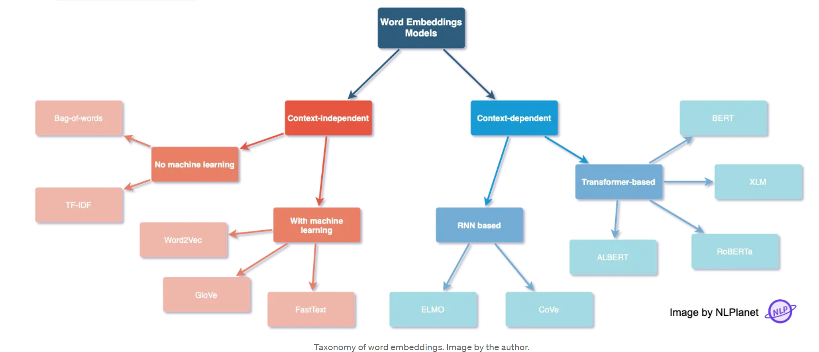
Word Embeddings Background
Word embeddings are numerical representations of words that capture semantic relationships and contextual information, enabling machines to understand and process human language more effectively. Various techniques, are used word embeddings by mapping words to high-dimensional vectors based on their patterns, global word similarities, or sub word information. These embeddings are fundamental to natural language processing tasks, including sentiment analysis, machine translation, and document classification, facilitating more accurate and efficient language understanding by machine learning models.

Slide 4
Methodology Used
Medical domain word embedding model used to generate vector from text instead of general embedding model. Reason : medical domain word embeddings are better suited for healthcare tasks due to their ability to capture domain-specific semantics and contextual nuances
Used Multiple Pre-trained model for this task, fine-tuned one of model to see performance improvement
Model Used : 1) BIOClinicalBert 2) PubMedBert 3) BIOGPT 4) BIOMISTRAL
Used Similarity measure (cosine similarity ) to compare various embedding output

Slide 5
Approach & Script details:
BIOGPT.py -> This consist pretrained BIOGPT model , downloaded from hugging face . This is used to generate embedding from clinical notes , and used cosine similarity measure to compare embedding of two sentences from note and medical concept file
FineTuning_clinicalBert.py -> This consist pretrained BIO_CLinicalBERT model , downloaded from hugging face , Then fine tuned the model on the given dataset to see performance improvement .
BIO_MISTRAL.py -> This consist pretrained BIOMISTRAL pretrained model, this model size was around 15 GB , so used qunatized version which is apprx 4 GB , but it required gpu to run , hence run this model on collab for gpu support
ClinicalBert.py -> This consist pretrained BIO_CLinicalBERT model , downloaded from hugging face . This is used to generate embedding from clinical notes , and used cosine similarity measure to compare embedding of two sentences from note and medical concept file , also used T-SNE for word embedding visualisation.
PubmedBert.py -> This consist pretrained BiomedNLP-PubMedBERT-base-uncased-abstract-fulltext
model , downloaded from hugging face . This is used to generate embedding from clinical notes , and used cosine similarity measure to compare embedding of two sentences from note and medical concept file ,also used T-SNE for word embedding visualisation.

Slide 6
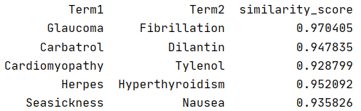
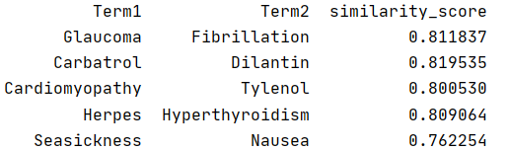
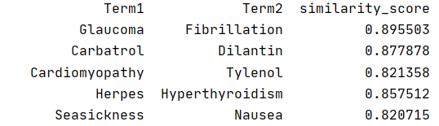
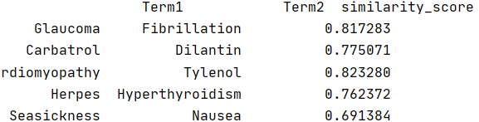
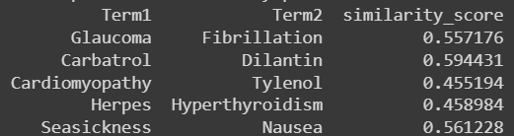
Embedding Comparison Similarity score on Medical Concept
PubMed Bert (TOP SCORE) Clinical Bert
BIOGPT Fine-Tuned Clinical Bert BIO MISTRAL

Slide 7
Model | Total words count | Word Similarity Score >=80 | Similarity Score <80 | Similarity Score >=90
Clinical Bert | 566 | 344 (61%) | 222 (39 %) | 45 (8 %)
PubMed Bert | 566 | 566 (100%) | 0 (0%) | 552 (97 %)
BIO GPT | 566 | 524 (93 %) | 42 (7.4 %) | 40 (7 %)
BIO MISTRAL | 566 | 0 (0%) | 566 (100%) | 0 (0 %)
Model | Inference time for similarity score(sec)
Clinical Bert | 76 sec
Pub Med Bert | 70.3 sec
BIO GPT | 263 sec
BIO MISTRAL | 450 sec
Finding :From above it clearly seems PubMed BERT & BIO GPT are giving good score and PubMed Bert is fastest of all

Slide 8
Similarity Score between clinical note sentences
Pub Med Bert
BIO GPT
Clinical Bert
BIO MISTRAL
Finding : Since first two sentence belong to same class and it has similar words in it , technically similarity score should be high. We can see this is being supported by Pub Med Bert , BIO GPT better compare to remaining

Slide 9
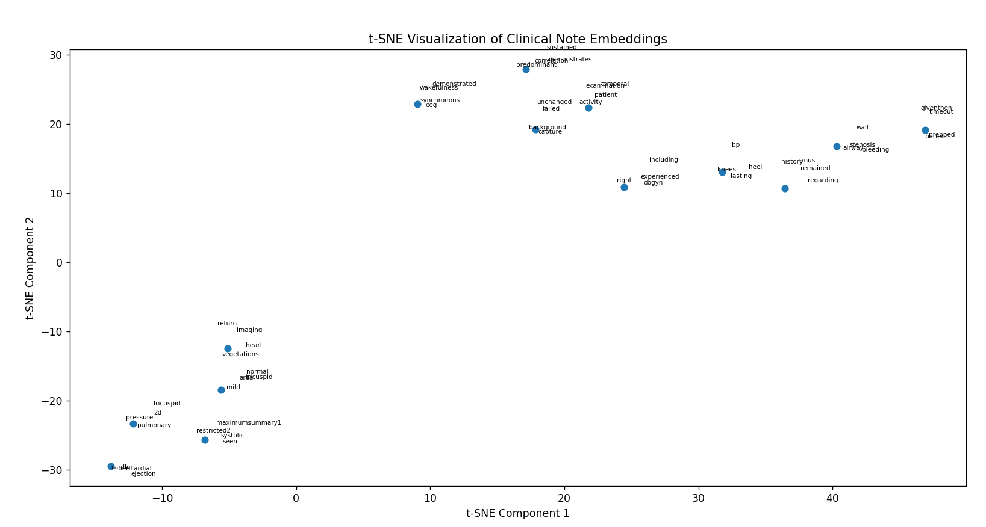
Embedding Visualization
Clinical Bert

Slide 10
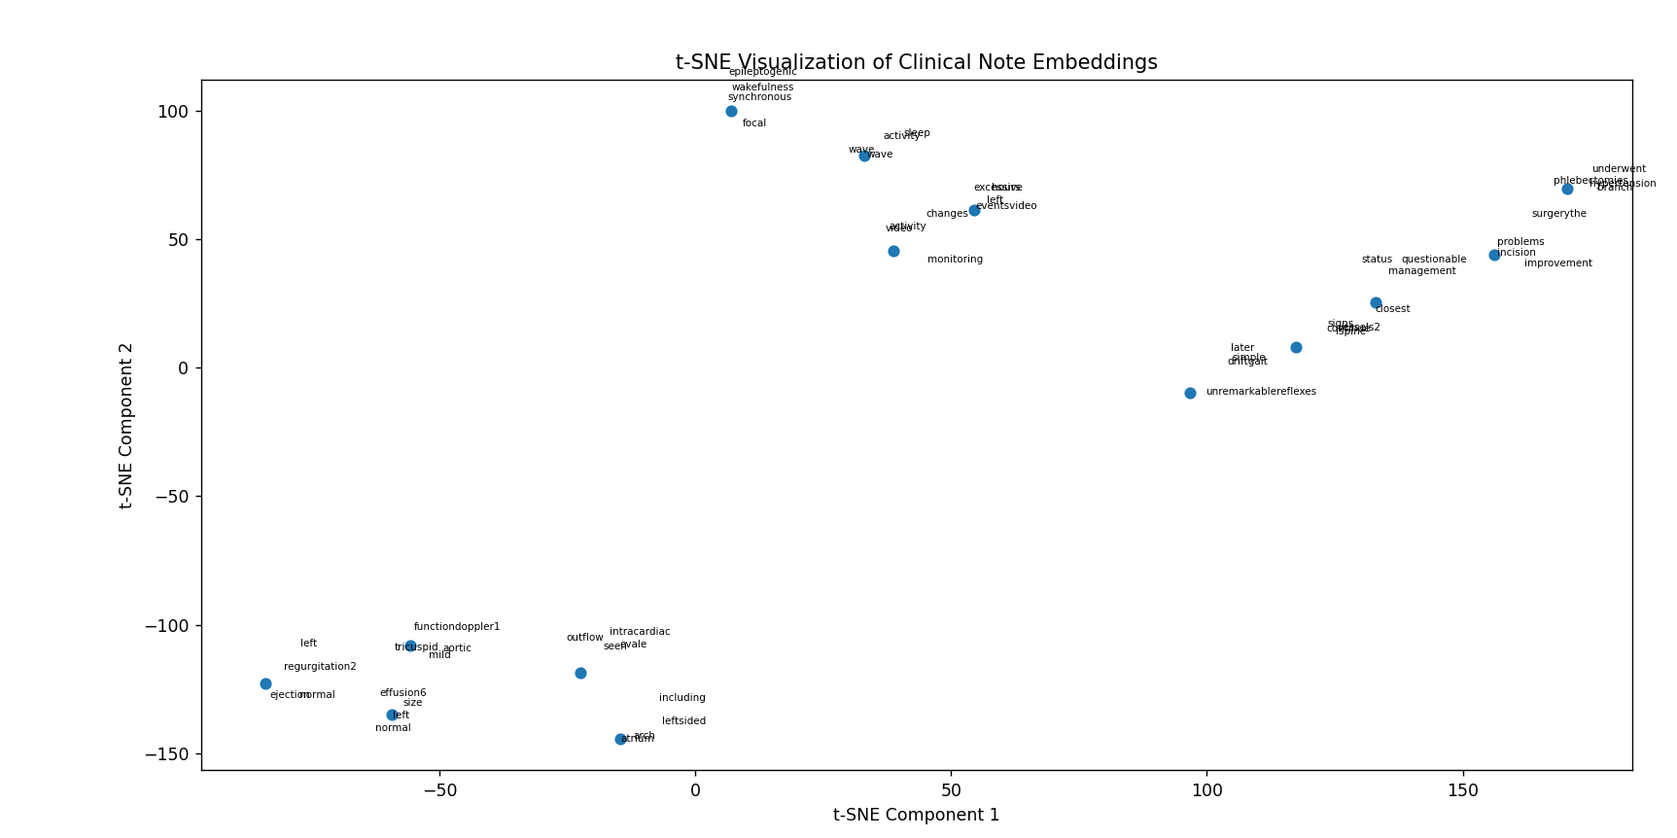
Pub med Bert

Slide 11
Model Comparison
Name | Base Model | Data/Concept | Size | Inference time (in sec)
Clinical Bert | BIOBERT | MIMIC III | 436 MB | 76 sec
PubMed Bert | BERT | PubMed | 440 MB | 70.3 sec
BIO MISTRAL | Mistral (LLM) | PubMed Central | 4.68 GB (Quantized) | 450 sec
BIO GPT | GPT (LLM) | Pub Med Abstract | 1.56 GB | 263 sec

Slide 12
Use Case Recommendation
Pub Med Bert are performing best among all on this clinical notes based on similarity score Other two are 1) BIO GPT and 2) Bio Clinical Bert giving decent performance sequentially.
Pub Med Bert are having least inference time 70.3 sec following by Bio clinical Bert.
BIO Mistral is not good option for this use case. One reason can be experimented with quantized version because of size issue , which is worst performing among all .
Fine tuned BIO Clinical Bert on this dataset but not much improvement in accuracy as dataset is less , finetuning on more dataset might increase performance
If accuracy is more important than latency and memory usage here , then top 2 model recommendation would be : 1) Pub Med Bert 2) BIO GPT
Embedding model can be evaluated further on downstream task like classification, NER, QA to take a firm decision about choosing the most suitable model for particular use case .

